Slide 1
Writing an Argumentative Essay
Based on Purdue Owl’s “Argumentative Essays”

Slide 2

What is an Argumentative Essay?
The argumentative essay is a genre of writing
that requires the writer to:
Develop a topic via researching credible sources
Create a clear, concise, and defined thesis statement that occurs in the first paragraph of the essay
Construct body paragraphs that include evidential support (whether factual, logical, statistical, or anecdotal)
Write in proper argumentative style; i.e. logical transitions and a firm and concise tone
Develop a conclusion that does not simply restate the thesis, but readdresses it in light of the evidence provided

Slide 3
Have you chosen your topic yet?
If not, use this presentation as a means to brainstorm.
If so, pay close attention to how this presentation applies to your topic!

Slide 4
Credible Sourcing
Published books
*available at our duPont-Ball Library
Peer-reviewed, academic journals
*available through our duPont-Ball Library website
An argumentative essay may warrant reference to newspaper articles or other less reputable sources. When in doubt, ask your professor whether your source is a credible one.

Slide 5
Flow chart on researching here, Preliminary tips
Good academic writing is considered “direct.”
  Deal immediately with the topic at hand without unnecessary information/examples
  Use clear and precise language even to describe taboo topics or abstract ideas
Consider using a flow chart to connect premises/claims to evidence/sources to conclusions/applications
Bubble maps can help keep you focused on a main idea by linking sections or arguments back to the central argument

Slide 6
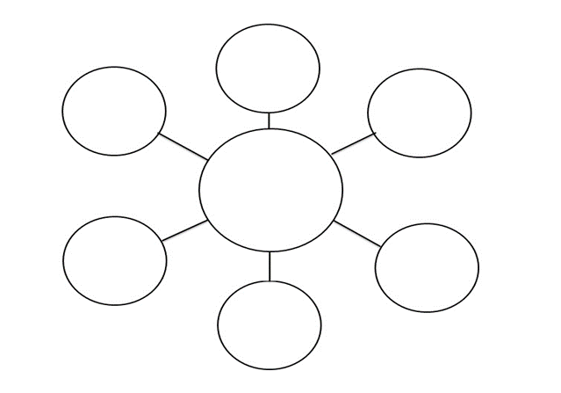
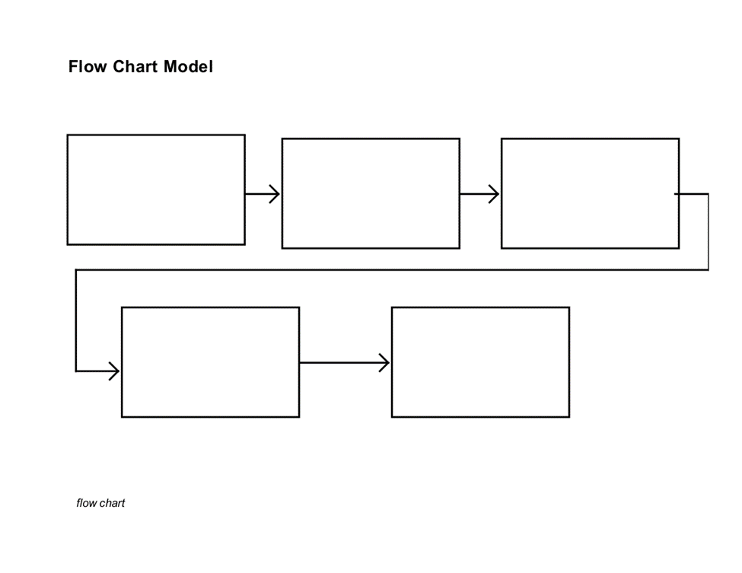
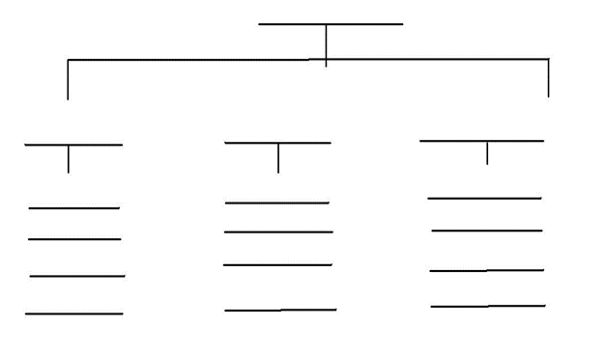
Chart Examples

Slide 7
What is a Good Argument?
Consider an argument that:
Can be support with factual evidence
Is specific enough to hold a focus
Has multiple perspectives and stances
You are passionate about

Slide 8
Elements of a Convincing Argument
Authoritative voice, “Ethos”
  What makes you a qualified writer on the topic?
  Draw from expertise of other credible theorists, or may draw from personal experience
Appeal to reason, “Logos”
  Where logical statements come into play
  The reader is lead to agree with you because conclusions/implications follow reasonably from premises
Appeal to audience, “Pathos”
  Often misunderstood as a purely emotional appeal, but is really a method of finding common ground with the reader
  Ex: the writer can appeal to ethical, humanist ideals, assuming the audience is a generally ethical crowd

Slide 9
Examples
Ethos
“You know me - I've taught Sunday School at your church for years, babysat your children, and served as a playground director for many summers - so you know I can run your preschool.”
Pathos
“After years of this type of disrespect from your boss, countless hours wasted, birthdays missed… it's time that you took a stand.”
Logos
“More than one hundred peer-reviewed studies have been conducted over the past decade, and none of them suggests that this is an effective treatment for hair loss.”

Slide 10
Writing a Thesis Statement
A thesis is not:
A title
An announcement of the subject
A statement or absolute fact
The MLA Handbook or Writer of Research Papers, 7th ed. defines a thesis statement as “a single sentence that formulates both your topic and your point of view.”

Slide 11
Writing a Thesis Statement
A good thesis statement is unified:
Disjointed: | “Detective stories are not a high form of literature, but people have always been fascinated by them, and many fine writers have experimented with them.”
Concise: | “Detectives stories appeal to the basic human desire for thrills.”

Slide 12
Writing a Thesis Statement
Try to be as specific as possible
without providing too much detail:
Vague: | “James Joyce’s Ulysses is very good.”
Better: | “James Joyce’s Ulysses helped create a new way for writers to deal with the unconscious.”
Best: | “James Joyce’s Ulysses helped create a new way for writers to deal with the unconscious by utilizing the findings of Freudian Psychology and introducing the techniques of literary stream-of-consciousness.”

Slide 13
The Tolumin Method
Claim: Your thesis/argument topic
Data: Evidence and research that you will use to support your thesis
Warrant/Bridge: Explanation of the data and how it supports your thesis; The underlying assumption that connects your data to your claim
Backing/Foundation: Additional information that is necessary to support your warrant/bridge
Counterargument: An argument that disagrees with your thesis/argument
Rebuttal: Explanation and evidence that disagrees with the counterargument

Slide 14
Incorporating Sources
Through the Tolumin Method
Claim: Hybrid cars are an effective strategy to fight pollution.
Data 1: Driving a private car is a typical citizen’s most air polluting activity.
Warrant 1: Because cars are the largest source of private, as opposed to industry produced, air pollution, switching to hybrid cars should have an impact on fighting pollution.
Data 2: Each vehicle produced is going to stay n the road for roughly 12 to 15 years.
Warrant 2: Cars generally have a long lifespan, meaning that a decision to switch to a hybrid car will make a long-term impact on pollution levels.

Slide 15
Incorporating Sources
Through the Tolumin Method
Data 3: Hybrid cars combine a gasoline engine with a battery-powered electric motor.
Warrant 3: This combination of technologies means that less pollution is produced. According to ineedtoknow.org “the hybrid engine of the Prius, made by Toyota, produces 90 percent fewer harmful emissions than a comparable gasoline engine.”

Slide 16
Cite Your Sources
When you use words or ideas from any source (whether it is a book, a website, a video, a television show, or a person you interviewed)
When you use or reprint images, charts, graphs, or other data from any source
When in doubt, cite (or ask your instructor)

Slide 17
Plagiarism
Common issues include:
  Neglecting to cite information that is not common knowledge
  Neglecting to use quotation marks around borrowed words.
  Neglecting to cite information or ideas that were summarized or paraphrased
  Incorrectly paraphrasing (for example, changing only a word or two)
Stetson’s Honor Pledge does not distinguish between intentional plagiarism and improper use of sources. Therefore, students must use care when working with sources and know when and how to give credit to sources.

Slide 18
The Counterargument
The counterargument addresses the claims that oppose your audience.
It may be located before or after your main claim.
It demonstrates your credibility.
It respectfully recognizes concerns that your audience might have.
For this reason, you must be both tactful and firm when presenting a counterargument.

Slide 19
Revisiting the Tolumin Method
Counterargument: Instead of focusing on cars, which still encourages a culture of driving even if it cuts down on pollution, the nation should focus on building and encouraging use of mass transit systems.
Rebuttal: While mass transit is an environmentally sound idea that should be encouraged, it is not feasible in many rural and suburban areas, or for people who must commute to work; thus hybrid cars are a better solution for much of the nation’s population.

Slide 20
Argumentative Style
Academic writers in argumentative essays generally keep a tone of high certainty, meaning their assertions are not too weak.
Writers should avoid hedging in argumentative essays, as this vague language lowers the validity of an argument.
Hedge Words:
  Probably, will, should, might, maybe
  Perhaps, usually, likely

Slide 21
Pronoun Use
“I”
  The first person perspective is not forbidden in formal essays, but some professors and genres of writing discourage it
  It places importance on the writer and his/her experiences/opinions rather than on the subject material
“We”
  Is rarely used because it refers to a specific group of individuals that often remains ill-defined
  May run into the problem of misrepresentation
“You”
  Is most discouraged because of misrepresentation—the writer cannot know for sure who the reader is and so should not make assumptions
  For hypotheticals, use “one”
“They”
  Issue with gendered pronouns in English: “his or her” excludes gender ambiguous people and “they” refers to plural third person, not singular.
  When in doubt, use “one”

Slide 22
What makes an essay flow?
  Using transition statements in
  between topic paragraphs
  Linking sentences and ideas
  together with conjunctions
  Having a clear and concise organization
  where supporting ideas refer back to the
  argument of paper

Slide 23
Transitioning in an Argumentative Essay
“It is a good idea to continue one paragraph where another leaves off. Picking up key phrases from the previous paragraph and highlighting them in the next can create an obvious progression for readers.”
Given/New sentence formation:
  The first part of the sentence refers to the fact established previously in the essay (given), while the last part springboards off the given facts to provide more information/argumentation/analysis (new)

Slide 24
Example I
“Overall, Management Systems International has logged increased sales in every sector, leading to a significant rise in third-quarter profits”
Disjoint:
“Another important thing to note is that the corporation had expanded its international influence.”
Building:
“These impressive profits are largely due to the corporation’s expanded international influence.”
Example II
“Fearing for the loss of Danish lands, Christian IV signed the Treaty of Lubeck, effectively ending the Danish phase of the 30 Years War”
Vague:
“But then something else significant happened. The Swedish intervention began.”
Contextual:
“Shortly after Danish forces withdrew, the Swedish intervention began.”

Slide 25
Concluding
The conclusion of an argumentative essay should rearticulate your thesis and explain the importance of your claim.
Some conclusions consider solutions to the argument at hand.
Some conclusions make predictions on the future of the argument.

Slide 26
The Tolumin Method:
Argumentative Essay Example
Claim: Your thesis/argument topic
Data: Evidence and research that you will use to support your thesis
Warrant/Bridge: Explanation of the data and how it supports your thesis; The underlying assumption that connects your data to your claim
Backing/Foundation: Additional information that is necessary to support your warrant/bridge
Counterargument: An argument that disagrees with your thesis/argument
Rebuttal: Explanation and evidence that disagrees with the counterargument
https://www.mesacc.edu/~paoih30491/ArgumentEssay2.pdf

Slide 27
References
http://academicguides.waldenu.edu/writingcenter/scholarlyvoice/avoidingbias
https://owl.english.purdue.edu/owl/resource/683/01/
https://owl.purdue.edu/owl/general_writing/academic_writing/essay_writing/argumentative_essays.html
https://owl.purdue.edu/owl/general_writing/common_writing_assignments/argument_papers/index.html
https://www.mesacc.edu/~paoih30491/ArgumentSampleEssays.html#MarkAgainst

